Slide 1
Lesson 07 Introduction to Complex Numbers
Activity Sheet Slides
E114 – Mathematics for Engineering

Slide 2
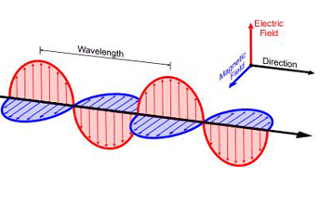
Scenario
Complex numbers are widely used in the
field of electrical and electronic applications in which electromagnetic radiations are often studied.
An electromagnetic radiation consists of two
components: electric and magnetic fields.
Rather than trying to describe
an electromagnetic field by two real quantities
(electric field strength and magnetic field strength),
it is best described as a single complex number, of which the
electric and magnetic components are simply the real and imaginary parts of the complex number.
Source: Google image, http://www.livescience.com/38169-electromagnetism.html

Slide 3
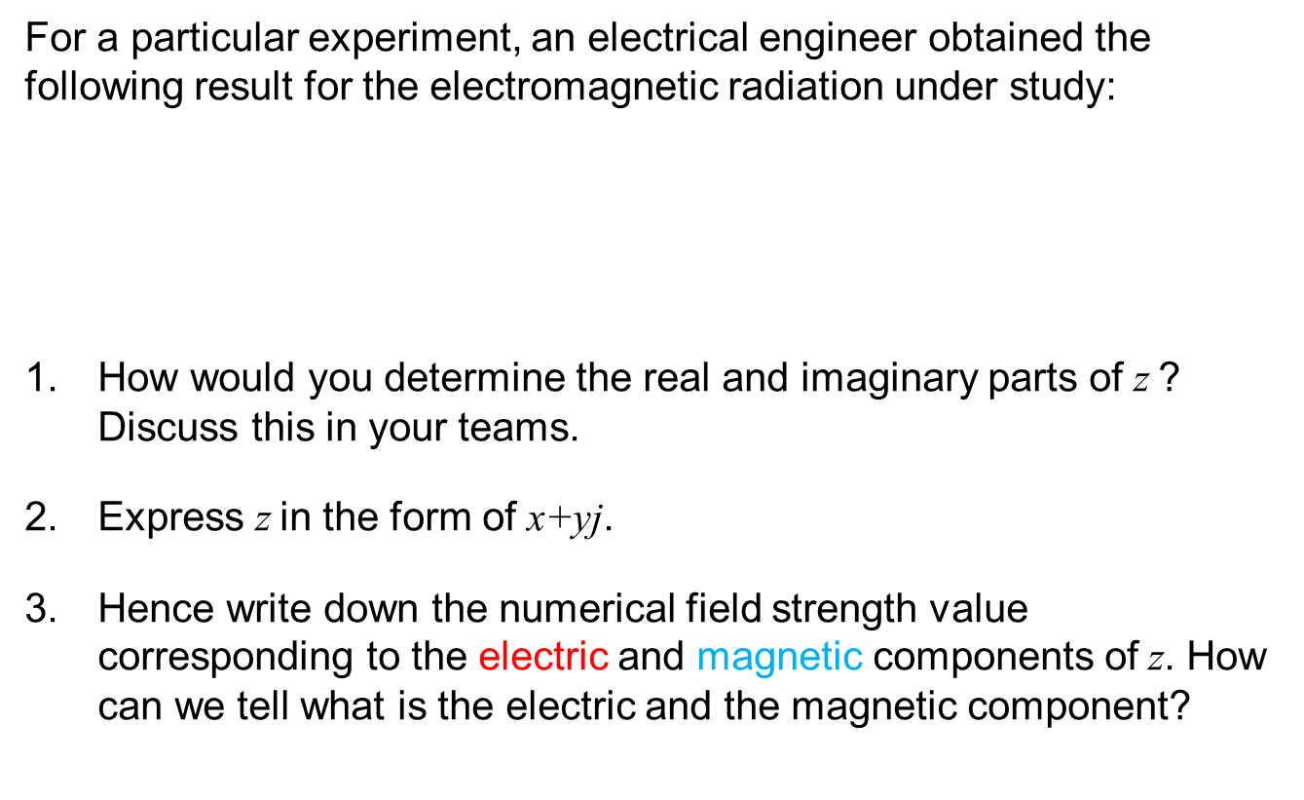
Scenario Tasks
For a particular experiment, an electrical engineer obtained the following result for the electromagnetic radiation under study:
How would you determine the real and imaginary parts of z ? Discuss this in your teams.
Express z in the form of x+yj.
3. Hence write down the numerical field strength value corresponding to the electric and magnetic components of z. How can we tell what is the electric and the magnetic component?

Slide 4
Scenario Definition Template
What We Know:
Electric component is represented by the real part and magnetic component is represented by the imaginary part of a complex number
The complex number z given by the study
To simplify and express z in terms of x+yj
What We Don’t Know:
What are complex numbers?
What is the real part and imaginary part of a complex number?
How do we apply basic operations on complex numbers to obtain the simplified form x+yj?
What We Need to Find Out:
Complex numbers and their representation
The various arithmetic operations on complex numbers (addition, subtraction, multiplication, division etc)
4

Slide 5
Lesson Overview
S/N | Concepts | Slide Number
1 | Introduction to Complex Numbers | 6-7
2 | Complex Roots of a Quadratic Equation | 8-10
3 | Point Representation of a Complex Number in an Argand Diagram | 11-12
4 | Conjugate Complex Numbers | 13-14
5 | Uniqueness Property of a Complex Number | 15-16
6 | Addition of Complex Numbers | 17
7 | Subtraction of Complex Numbers | 18-19
8 | Multiplication of a Complex Number by a Real Number | 21
9 | Multiplication of Two Complex Numbers | 22-25
10 | Division of Two Complex Numbers (CL) | 26-27

Slide 6
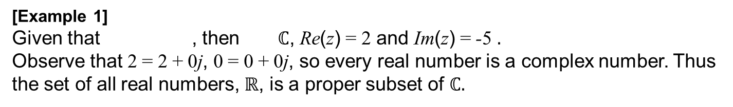

Introduction to Complex Numbers
A number of the form z=x+yj, where x, y are real numbers, is called a complex number. By definition, .
Note:
Some textbooks use the letter i instead of j. In this module, we shall be using j.
Also, complex number can also be expressed in the form z=x+jy.
The above form of the complex number is called the Cartesian (or rectangular) form. [We will learn another form – the Euler form – in the subsequent lesson L08]
We use ℂ to denote the set of all complex numbers,
i.e. ℂ= { ℝ }
x is called the real part of z, and is denoted by Re(z).
y is called the imaginary part of z, and is denoted by Im(z).
If x = 0$,$ then z = yj is called an imaginary number.
If y = 0$,$then z=x is called a real number.
[Example 1]
Given that , then ℂ, Re(z) = 2 and Im(z) = -5 $.$
Observe that 2 = 2 + 0j, 0 = 0 + 0j, so every real number is a complex number. Thus the set of all real numbers, ℝ, is a proper subset of ℂ$.$

Slide 7

Think-Pair-Share - Introduction to Complex numbers
Take a few minutes to understand the real and imaginary
parts of z. Can you explain this to your partner next to you?
In pairs, write down the real and imaginary parts of z for the following complex numbers:
i. z = 0.17 – 3.52 j
ii. z = 3j – 0.28

Slide 8

Complex Roots of a Quadratic Equation
Consider the quadratic equation:
ax²+bx+c=0, where a,b,c ℝ.
By the quadratic formula,
If , then the equation has real roots, i.e. we can find the real number $x$ that will satisfy the equation.
If , then the equation has complex roots.
Let us consider the equation
Recall that , so the complex roots are

Slide 9
Complex Roots of a Quadratic Equation
[Example 2]
Find the roots of x²-4x+13=0.
[Solution]
By the quadratic formula,
The two complex roots are 2 – 3j and 2+3j.

Slide 10
Test Yourself
– Complex Roots of a Quadratic Equation
Determine the roots of the quadratic equation:
x² + 2x + 3 = 0

Slide 11
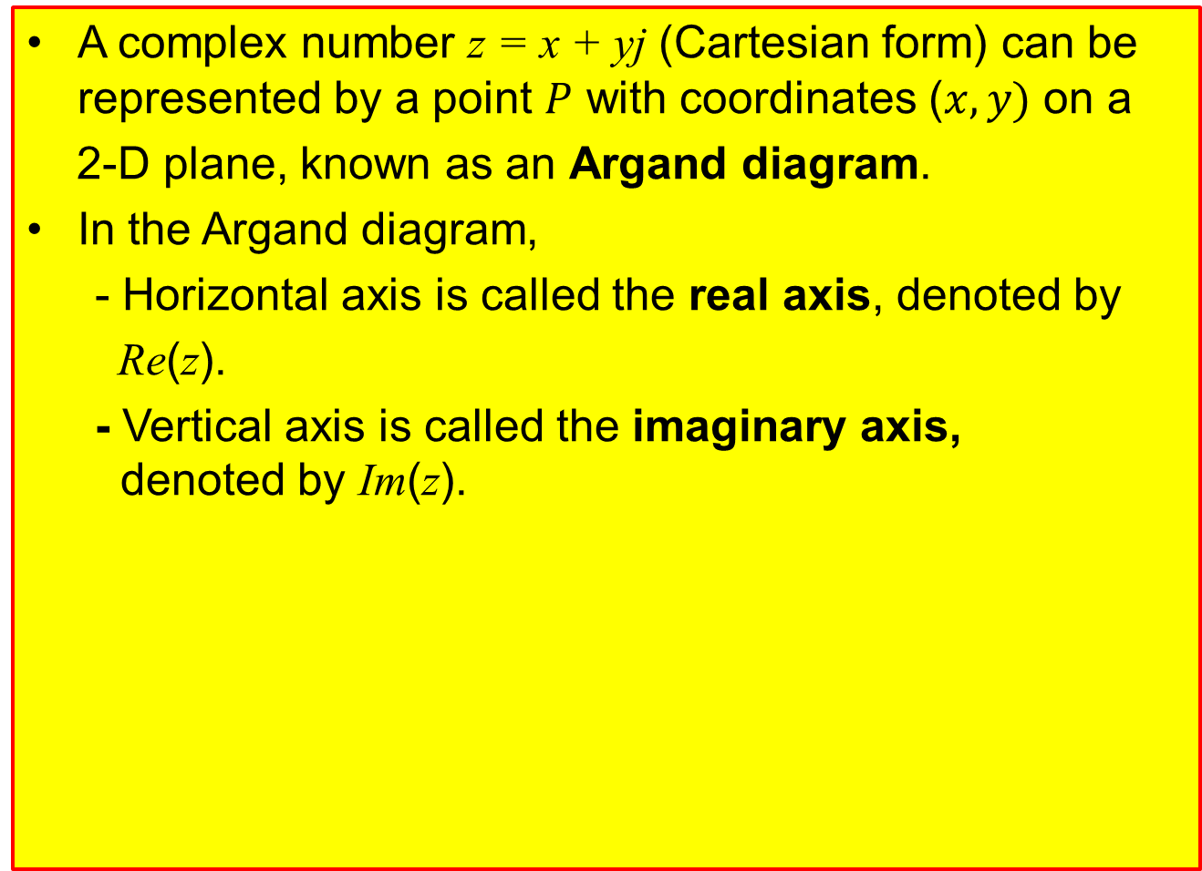
Point Representation of a Complex Number in an Argand Diagram
A complex number z = x + yj (Cartesian form) can be represented by a point $P$ with coordinates ($x,y)$ on a
2-D plane, known as an Argand diagram.
In the Argand diagram,
- Horizontal axis is called the real axis, denoted by
Re(z).
- Vertical axis is called the imaginary axis, denoted by Im(z).
Im(z)
P(x, y)
Re(z)
Point representation of a complex number z = x + yj in the Argand diagram

Slide 12
Point Representation of a Complex Number in an Argand Diagram
[Example 3]
Represent the following complex numbers on a single Argand diagram:
i. z₁ = 1 + 2j
ii.
[Solution]
Let P₁ and P₂ represent the complex numbers z₁ and z₂ respectively on the Argand diagram.
Im(z)
P₁ (1,2)
Re(z)
P₂ (-2,-3)

Slide 13
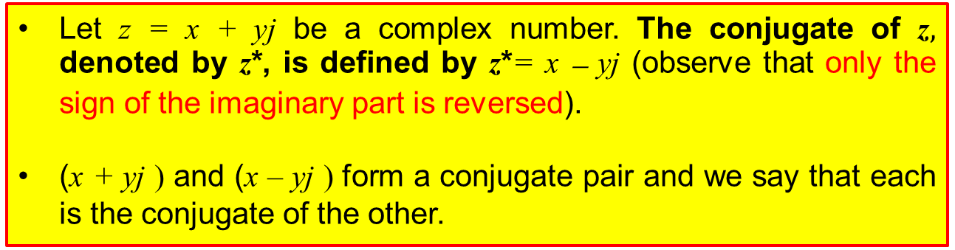
Conjugate Complex Numbers
Let z = x + yj be a complex number. The conjugate of z$,$ denoted by z*, is defined by z*= x – yj (observe that only the sign of the imaginary part is reversed).
(x + yj ) and (x – yj ) form a conjugate pair and we say that each is the conjugate of the other.
[Example 4]
Write down the conjugate of each of the following complex numbers:
i.
ii.
iii.
iv.
[Solution]
i.
ii.
iii.
iv.

Slide 14
Test Yourself – Conjugate Complex Numbers
Write down the conjugate of each of the following complex numbers:
i.
ii.
iii.
iv.

Slide 15
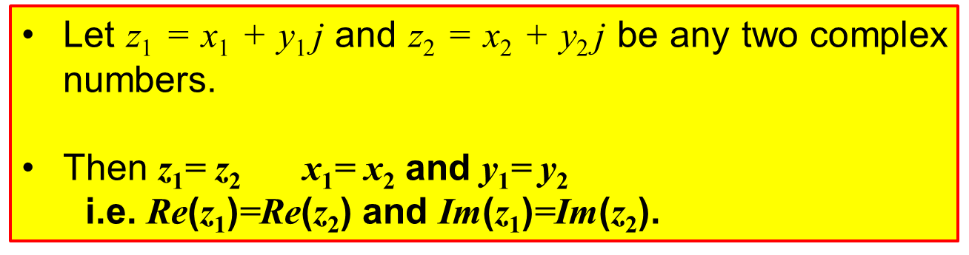
Uniqueness Property of a Complex Number
Let z₁ = x₁ + y₁ j and z₂ = x₂ + y₂ j be any two complex numbers.
Then z₁= z₂ x₁= x₂ and y₁= y₂
i.e. Re(z₁)=Re(z₂) and Im(z₁)=Im(z₂).
[Example 5]
Two complex numbers are such that z =2 + a j and w =–2b + 5 j, where a, b are unknown real numbers. It is known that z = w. Determine the values of a and b.
[Solution]
2 + aj = – 2b + 5j
Comparing on both sides,
Real parts: 2 = –2b
Imaginary parts: a=5

Slide 16
Test Yourself – Uniqueness Property of a Complex Number
Two complex numbers are such that z=(m – 1)+3j and w= – 6 + (n – 2) j, where m, n are unknown real numbers. It is known that z=w. Determine the values of m and n.

Slide 17
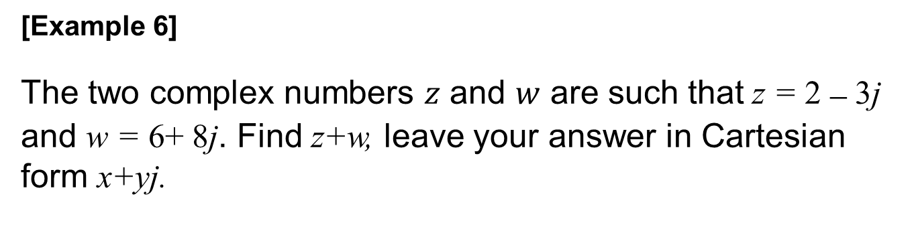
Addition of Complex Numbers
Let z₁ = x₁ + y₁ j and z₂ = x₂ + y₂ j be any two complex numbers.
Then z₁+ z₂= (x₁ + x₂) + (y₁ + y₂) j.
Addition is commutative, i.e. z₁ + z₂ = z₂ + z₁.
Addition is associative, i.e. z₁ + (z₂ + z₃) = (z₁ + z₂) + z₃
[Example 6]
The two complex numbers $z$ and $w$ are such that z = 2 – 3j and w = 6+ 8j. Find z+w, leave your answer in Cartesian form x+yj.
[Solution]

Slide 18
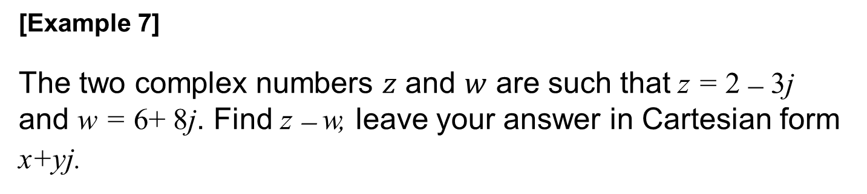
Subtraction of Complex Numbers
Let z₁ = x₁ + y₁ j and z₂ = x₂ + y₂ j be any two complex numbers.
Then z₁– z₂= (x₁ – x₂) + (y₁ – y₂) j.
[Example 7]
The two complex numbers $z$ and $w$ are such that z = 2 – 3j and w = 6+ 8j. Find z – w, leave your answer in Cartesian form x+yj.
[Solution]

Slide 19
Test Yourself – Kahoot.IT
Given that z₁=1+2j and z₂=3 – 4j, find:

Slide 20
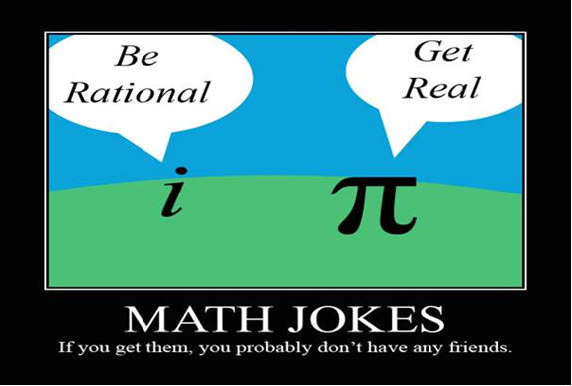
BRAIN BREAK

Slide 21
Multiplication of a Complex Number by a Real Number
Let z = x + yj be a complex number.
Then for any real number k, kz = kx + kyj.
[Example 8]
The complex number z is such that z=2 – 4j. Find 3z, leave your answer in Cartesian form x+yj.
[Solution]
3z

Slide 22
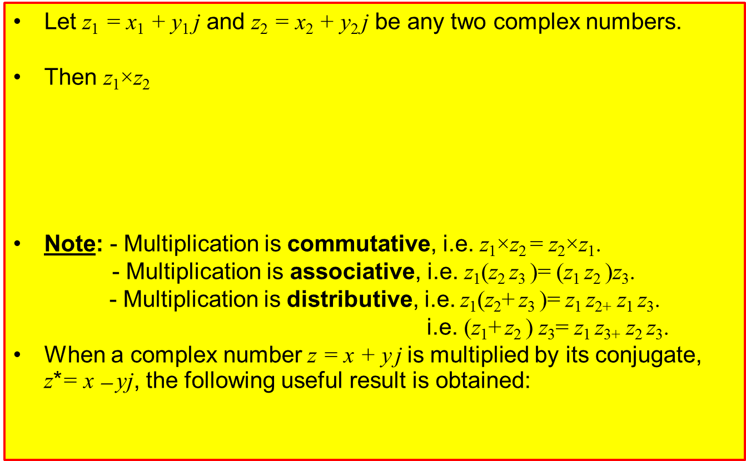
Multiplication of Two Complex Numbers
Let z₁ = x₁ + y₁ j and z₂ = x₂ + y₂ j be any two complex numbers.
Then z₁×z₂
Note: - Multiplication is commutative, i.e. z₁×z₂ = z₂×z₁.
- Multiplication is associative, i.e. z₁(z₂ z₃ )= (z₁ z₂ )z₃.
- Multiplication is distributive, i.e. z₁(z₂+ z₃ )= z₁ z₂₊ z₁ z₃.
i.e. (z₁+ z₂ ) z₃= z₁ z₃₊ z₂ z₃.
When a complex number z = x + y j is multiplied by its conjugate, z*= x – yj, the following useful result is obtained:
z × z*= x² + y²
Try to prove this by yourself!

Slide 23





Multiplication of Two Complex Numbers
[Example 9]
The two complex numbers z and w are such that z = 2 – 3j and w = 6+ 8j. Find z×w, leave your answer in Cartesian form x+yj.
z×w = (2–3j) (6+8j)
[Solution]
$=$12 + 16j
– 18j – 24j²
$=$12 + 16j –18j – 24(1)
Correct?
$=$12 + 16j –18j – 24(–1)
$=($12 + 24) + (16 –18) j
$=$ 36 – 2j

Slide 24
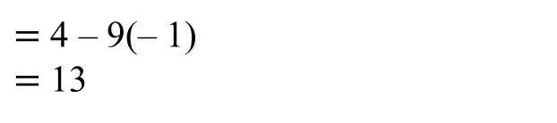
Multiplication of Two Complex Numbers
[Example 10]
If z = – 2 + 3j, write down its conjugate z*, and find z × z*, leave your answers in Cartesian form x+yj.
[Solution]
z*= – 2 – 3j
z × z*= (– 2)² + 3² = 13
Alternatively, we can also carry out the multiplication:
Note:
Observe that when we multiply a complex number by its conjugate, using the result
z × z*= x² + y²
would give us the answer more quickly. Hence, please remember this useful result.
z × z*= (– 2 + 3j) (– 2– 3j)
$=$ 4 + 6j
–6j – 9j²
$=$ 4 – 9(– 1)
$=$ 13

Slide 25
Test Yourself – Multiplication of Two Complex Numbers
Given that z₁ = 1 + 2j and z₂ = 3 – 4j, find:
i. – 5z₁
ii. z₁×z₂
iii. z₂×z₂*
iv. z₁²
Leave your answers in Cartesian form x+yj.

Slide 26
Division of Two Complex Numbers
Let z₁ = x₁ + y₁ j and z₂ = x₂ + y₂ j be any two complex numbers.
Then
Multiply the conjugate of denominator to both the numerator and the denominator.
[Example 11]
The two complex numbers $z$ and $w$ are such that z = 2 – 3j and w = 6+ 8j. Find leave your answer in Cartesian form x+yj.
[Solution]

Slide 27
Test Yourself – Division of Two Complex Numbers
Given that z₁ = 1 + 2j and z₂ = 3 – 4j, find , leave your answer in Cartesian form x+yj.

Slide 28
One-minute write
Please stop what you are doing and produce a written response to either of the following in only one minute:
Identify what you thought the most confusing point is from the seminar, or
Write down a question with respect to the concepts learnt so far.

Slide 29
Learning Objectives
Represent complex numbers in rectangular form using real and imaginary parts.
Perform basic mathematical operations (addition and subtraction) on complex numbers.
Solve quadratic equations involving complex roots.
Represent complex numbers on an Argand Diagram.
Perform mathematical operations (multiplication, division (CL)) and power on complex numbers.

